Slide 1
    Requirement Engineering

Slide 2
Introduction
The requirements of a system are the descriptions of the features or services that the system exhibits within the specified constraints.
The requirements collected from the customer are organized in some systematic manner and presented in the formal document called software requirements specification (SRS) document.
Requirements engineering is the process of gathering, analyzing, documenting, validating, and managing requirements.
The main goal of requirements engineering is to clearly understand the customer requirements and systematically organize these requirements in the SRS.

Slide 3
Types of requirements
Software requirements
Business
requirements
User and system requirements
Functional and nonfunctional requirements
Figure 5.1: Types of requirements

Slide 4
Business Requirements
Understanding the business rules or the processes of organization is vital to software development.
Business requirements define the project goal and the expected business benefits for doing the project.
The enterprise mission, values, priorities, and strategies must be known to understand the business requirements that cover higher level data models and scope of the models.
The business analyst is well versed in understanding the concept of business flow as well as the process being followed in the organization.

Slide 5
User Requirements
User requirements are the high-level abstract statements supplied by the customer, end users, or other stakeholders.
These requirements are translated into system requirements keeping in mind user’s views.
These requirements are generally represented in some natural language with pictorial representations or tables to understand the requirements.
User requirements may be ambiguous or incomplete in description with less product specification and little hardware/software configurations are stated in the user requirements.
There may be composite requirements with several complexities and confusions.

Slide 6
System Requirements
System requirements are the detailed and technical functionalities written in a systematic manner that are implemented in the business process to achieve the goal of user requirements.
These are considered as a contract between the client and the development organization.
System requirements are often expressed as documents in a structured manner using technical representations.
The system requirements consider customer ID, account type, bank name, consortium, PIN, communication link, hardware, and software. Also, an ATM will service one customer at a time.

Slide 7
Functional Requirements
Functional requirements are the behavior or functions that the system must support.
These are the attributes that characterize what the software does to fulfill the needs of the customer.
These can be business rules, administrative tasks, transactions, cancellations, authentication, authorization, external interfaces, legal or regulatory requirements, audit tracking, certification, reporting requirements, and historical data.

Slide 8
Nonfunctional Requirements
Nonfunctional requirements specify how a system must behave. These are qualities, standards, constraints upon the systems services that are specified with respect to a product, organization, and external environment.
Nonfunctional requirements are related to functional requirements, i.e., how efficiently, by how much volume, how fast, at what quality, how safely, etc., a function is performed by a particular system.
The examples of nonfunctional requirements are reliability, maintainability, performance, usability, security, scalability, capacity, availability, recoverability, serviceability, manageability, integrity, and interoperability.

Slide 9
Example: EtransQ
It is a web-based information system for suppliers, transporters, and agents to share a common platform and help in gaining profit.
Transporter
Supplier
EtransQ
Agent
Figure 5.2: Business architecture for EtransQ

Slide 10
Business requirements for ETransQ
The aim of EtransQ is to shape an online information- and knowledge-based system to be a recognized, professional, innovative, and profitable service.
The objectives of EtransQ are to
  provide the common platform for suppliers, transporters, and agents;
  provide an easy way to search for tenders and offers;
  build trust and relationships between consumers and service providers;
  provide easy and improved way of communication; and
  provide enough options to get the best deal available in the market.

Slide 11
User and system requirements for ETransQ
EtransQ system should provide a common platform for suppliers, agents, and transporters to share knowledge that will help them to grow their business.
The system requirements in this system are:
  The user should be able to communicate with other users connected with the system irrespective of their physical location.
  The system should be flexible enough to provide personalized search results for every registered user.
  The system should work in a secured manner.
  The information available should be genuine and reliable.

Slide 12
Functional Requirements for ETransQ
EtransQ system provides
  registration,
  association,
  quick search,
  tendering,
  offering, and
  testimonial services to its user.
  etc.

Slide 13
Nonfunctional Requirements for ETransQ
Availability
Recoverability
Extensibility
Maintainability
Privacy
Security
Compatibility
Usability
Stability
Reusability
Robustness

Slide 14
Requirement Engineering Process
  Requirement engineering is the key phase in software development which decides what to build and it provides the outline of the quality of the final product.
  Requirement engineering is the disciplined, process-oriented approach to the development and management of requirements.
The main issues involved in requirement engineering are
  discovering the requirements,
  technical organization of the requirements,
  ensuring correctness and completeness of the requirements,
  managing requirements that changes over time.

Slide 15

Requirement engineering process
Discovery
Requirement
elicitation
Organization
Requirement development
Requirement
management
Requirement
analysis
Documentation
Requirement
specification
Defect detection
and removal
Requirement
validation

Slide 16
Requirement Engineering Process
A typical requirement engineering process has two main aspects:
  Requirement development
  Requirement management
  Requirement development includes various activities, such as elicitation, analysis, specification and validation of requirements.
  Requirement management is concerned with managing requirements that change dynamically, controlling the baseline requirements, monitoring the commitments and consistency of requirements throughout software development.

Slide 17
Requirements Elicitation
Requirement elicitation aims to gather requirements from different perspectives to understand the customer needs in the real scenario.
The goals of requirement elicitation are to identify the different parties involved in the project as sources of requirements, gather requirement from different parties, write requirements in their original form as collected from the parties, and integrate these requirements.
Therefore, the system analyst involves domain experts, software engineers, clients, end users, sponsors, managers, vendors and suppliers, and other stakeholders and follows standards and guidelines to elicit requirements.

Slide 18
System analyst interaction
End users
Standards and guidelines
Client and customers
Vendors and suppliers
Business policies
System analyst
Managers
Developers
Sponsors

Slide 19
System analyst
The role of the system analyst is multifunctional, fascinating, and challenging as compared to other people in the organization.
A system analyst is the person who interacts with different people, understands the business needs, and has knowledge of computing.
The skills of the system analyst include programming experience, problem solving, interpersonal savvy, IT expertise, and political savvy. He acts as a broker and needs to be a team player.
He should also have good communication and decision-making skills.
He should be able to motivate others and should have sound business awareness.

Slide 20
Challenges in requirements elicitation
The main challenges of requirements elicitation are
  identification of problem scope,
  identification of stakeholders,
  understanding of problem, and
  volatility of requirements.
Stakeholders are generally unable to express the complete requirement at a time and in an appropriate language.
There may be conflicts in the views of stakeholders.
It may happen that the analyst is not aware of the problem domain and the business scenario.

Slide 21
Fact-Finding Techniques
Fact-finding techniques are used to discover the information pertaining to system development.
Some of the popular techniques are
  interviewing,
  questionnaires,
  joint applications development (JAD),
  onsite observation,
  prototyping,
  viewpoints,
  and review records

Slide 22
Fact-Finding Techniques
Interviewing
  Interview involves eliciting requirements through face to face interaction with clients, end-users, domain experts, or other stakeholders associated with the project.
  They are conducted to gather facts, verify and clarify facts, identify requirements, and determine ideas and opinions.
  There are two types of interviews: unstructured interviews and structured interviews.
  An unstructured interview aims at eliciting various issues related to stakeholders and the existing business system perspectives. There is no predefined agenda and thus general questions are asked from the stakeholders.
  A structured interview is conducted to elicit specific requirements and therefore the stakeholders are asked to answer specific questions.

Slide 23
Fact-Finding Techniques
Questionnaires
  Questionnaires are used to collect and record large amount of qualitative as well as quantitative data from a number of people.
  The system analyst prepares a series of questions in a logical manner, supplemented by multiple choice answers and instructions for filling the questionnaires.
  It is a quick method of data collection and inexpensive as compared to interviews.
  It provides standardized and uniform responses from people as questions are designed objectively.
  However, it is very difficult to design logical and unambiguous questions.
  A very few people take interest in responding and carefully filling questionnaires.

Slide 24
Fact-Finding Techniques
Joint Applications Development (JAD)
  It is a structured group meeting just like workshop where the customer, designer, and other experts meet together for the purpose of identifying and understanding the problems to define requirements.
  The JAD session has predefined agenda and purpose.
  It includes various participants with their well-defined roles, such as facilitator, sponsors, end users, managers, IT staff, designers, etc.
  The JAD meeting is conducted to identify and understand problems, resolve conflicts, generate ideas, and discuss some alternatives and the best solutions.
  Brainstorming and focus group techniques are used for JAD.

Slide 25
Fact-Finding Techniques
Onsite observation
  The system analyst personally visits the client site organization, observes the functioning of the system, understands the flow of documents and the users of the system, etc.
  It helps the system analyst to gain insight into the working of the system instead documentation.
  Through constant observation, the system analyst identifies critical requirements and their influence in the system development.
  Users may feel uncomfortable if someone observes their work.

Slide 26
Fact-Finding Techniques
Prototyping
  Prototyping technique is helpful in situations where it is difficult to discover and understand the requirements and where early feedback from the customer is needed.
  An initial version of the final product called prototype is developed that can give clues to the client to provide and think on additional requirements. The initial version will be changed and a new prototype is developed.
  Prototype development is a repetitive process that continues until the product meets the business needs or requirements.
  In this way, prototype is corrected, enhanced, or refined to reflect the new requirements.
  Prototyping can be costly if it is repeated many times

Slide 27
Fact-Finding Techniques
Viewpoints
  Viewpoint is a way of structuring requirements to represent the perspectives of different stakeholders as there is no single correct way to analyze the system requirements.
  Stakeholders may be classified under different viewpoints:
    direct (who directly interact with the system),
    indirect (who indirectly interact with the system),
    domain (represent the domain standards and constraints) viewpoints.
  The collected viewpoints are classified and evaluated under the system’s circumstances and finally, it is integrated into the normal requirement engineering process.

Slide 28
Fact-Finding Techniques
Review records
  Reviewing the existing documents is a good way of gathering requirements.
  The information related to the system is found in the documents such as manual of the working process, newspapers, magazines, journals, etc.
  The existing forms, reports, and procedures help to understand the guidelines of a process to identify the business rules, discrepancies, and redundancies.
  This method is beneficial to new employees or consultants working on the project.

Slide 29
Requirements Analysis
In requirement analysis, we analyze stakeholders’ needs, constraints, assumptions, qualifications, and other information relevant to the proposed system and organize them in a systematic manner.
It includes various activities, such as classification, organization, prioritization, negotiation, and modeling requirements.
The draft requirements are analyzed to verify their correctness and completeness.

Slide 30
Requirements Analysis
During requirement analysis, models are prepared to analyze the requirements.
The following analysis techniques are generally used for the modeling of requirements:
  Structured analysis
  Data-oriented analysis
  Object-oriented analysis
  Prototyping

Slide 31
Structured Analysis
Structured analysis is also referred to as process modeling or data flow modeling.
It focuses on transforming the documented requirements in the form of processes of the system.
During transformation, it follows a top-down functional decomposition process in which the system is considered a single process and it is further decomposed into several sub-processes to solve the problem.
Thus, the aim of structured analysis is to understand the work flow of the system that the user performs in the existing system of the organization.
Structured analysis uses a graphical tool called data flow diagrams (DFD), which represent the system behavior.

Slide 32
Data Flow Diagram (DFD)
  A DFD is a graphical tool that describes the flow of data through a system and the functions performed by the system.
  It shows the processes that receive input, perform a series of transformations, and produce the desired outcomes.
  It does not show the control information (time) at which processes are executed.
  DFD is also called a bubble chart or process model or information flow model.

Slide 33
Data Flow Diagram
A DFD has four different symbols:
  Process: A process is represented by a circle and it denotes transformations of the input data to produce the output data.
  Data flow: represent the movement of data, i.e., leaving one process and entering into another process. Data flows are represented by arrows, connecting one data transformation to another.
  Data store: Data store is the data at rest. It is represented in parallel lines.
  Actor: It is the external entity that represents the source or sink (destination of data). It is represented by a rectangle.

Slide 34
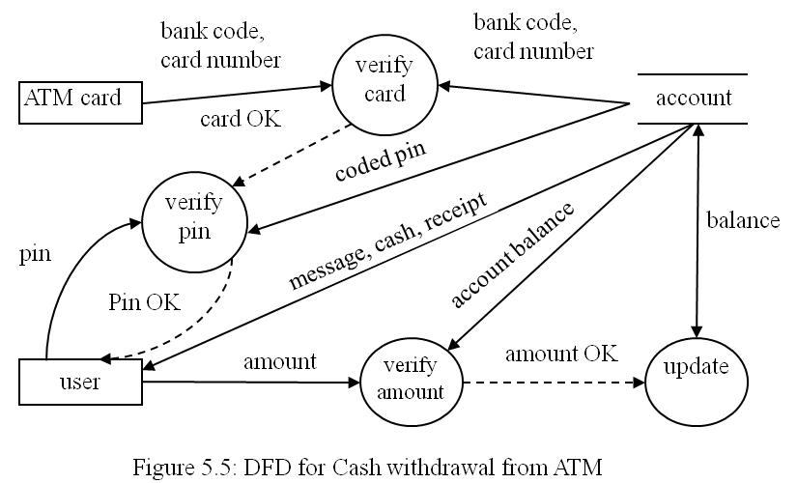
An example of DFD

Slide 35
Constructing DFD
The construction of the DFD starts with the high-level functionality of the system, which incorporates external inputs and outputs.
This abstract DFD is further decomposed into smaller functions with the same input and outputs.
The decomposed DFD is the elaborated and nested DFD with more concrete functionalities.
Decomposition of DFD at various levels to design a nested DFD is called leveling of DFD.
Sometimes, dotted lines are used to represent the control flow information. Control flow helps to decide the sequencing of the operations in the system.

Slide 36
Conventions in constructing DFD
Data flow diagrams at each level must be numbered for reference purposes, for example, level 0, level 1 etc.
Multiple data flow can be shown on single data flow line. A bidirectional arrow can be used as input and outflow (if same data is used) data or separate line can be used for input and output.
External agents/actors and data flow are represented using nouns; for example, stock, pin, university, transporter, etc.
Processes should be represented with verbs followed by nouns. Longer names must be connected with underscores (“_”) and these should be short but meaningful, e.g. sales_detail.
Avoid representation of control logics in the DFD.
Each process and data store must have at least one incoming data flow into it and one outgoing data flow leaving it.
There should not be any black hole in the system.

Slide 37
DFD Vs. Flowcharts
DFDs represent the flow of data through the system while flowcharts represent the flow of control in a program.
DFDs do not have branching and iteration of data whereas flowcharts have conditional and repetitive representation of processes.
A flowchart describes the sequence of processes in a program whereas a DFD does not show the procedural details.
Flowcharts represent the flow of control through an algorithm.
Flowcharts do not show the input, output, and storage of data in the system.
The DFD can be used to show the parallel processes executing in the system while flowcharts have only one process active at a time.

Slide 38
Data Dictionary
Data flows are used by the programmers in designing data structures and also it is used by testers to design test cases.
Such data structures may be primitive or composite.
Composite data structures may consist of several primitive data structures.
Also, longer composite data structures are difficult to write on the line of data flow in DFD.
Therefore, data flow and data structures are described in the data dictionary.
Data dictionary is metadata that describe composite data structures defined in the DFD.

Slide 39
Data Dictionary
Data dictionary is written using special symbols, such as “+” for composition, “*” for repetition, and “|” for selection.
The combinations of repeated data are written using “[ ]” symbol.
For example, a data dictionary for a restaurant bill is as follows:
restaurant_bill = dish_price + sales_tax + service_charge + seat_charge + grand_total
dish_price = [dish_name + quantity + price]*
seat_charge = [reserved_table | common_table]

Slide 40
Structured Analysis Method
Structured analysis is a systematic approach for requirement analysis that employs techniques and graphical tools to represent the scenario of the working system in an organization.
Structured analysis uses data flow diagrams and data dictionary for requirement analysis.
This approach begins with studying the existing system
  to understand the working of the system
  to design the context diagram,
  apply functional decomposition to subdivide the functional requirements,
  mark the boundary of the system to know what can be automated or what will be manual, and
  prepare the dictionary of the system.

Slide 41
Structured Analysis Method
Business need
Prepare the context diagram
Construct logical level 1 DFD
Decomposition of level 1 DFD
Identify man-machine boundary
Prepare data dictionary, process descriptions
Requirements specification
Figure 5.6: Structured analysis approach

Slide 42
Structured Analysis Method
Prepare Context Diagram
  The context diagram (or level 0 DFD) is the high-level representation of the proposed system after studying the physical DFD of the existing system. .
  The entire system is treated as a single process called bubble, with all its external entities.
  That is, the system is represented with main input and output data, process, and external entities.
  A Physical DFD is the representation of the real physical environment of a non-automated system.
  Logical DFD describes logical rather than physical entities. Processes might be implemented as programs, data might be considered as file or database, etc.

Slide 43
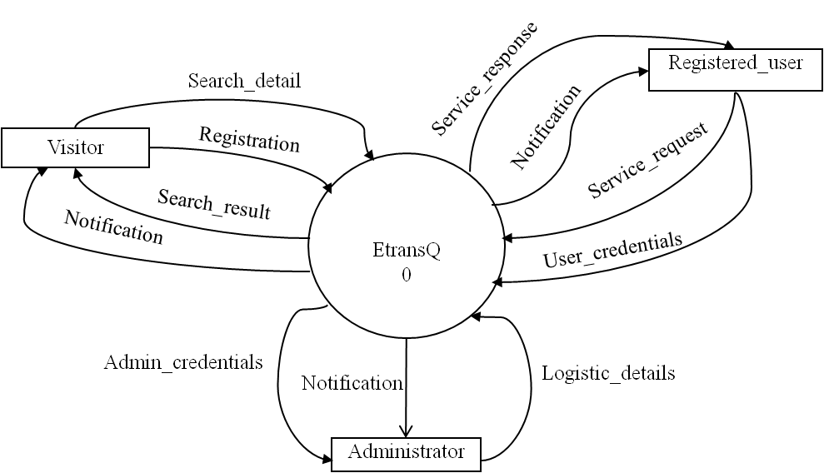
Structured Analysis Method
Context Diagram Example
Figure 5.7: Context diagram (level 0 DFD) for EtransQ

Slide 44
Structured Analysis Method
Construct Level 1 Logical DFD
Level 1 logical DFD includes the main functions supported by the proposed system.
The equivalent logical DFD for the existing physical DFD of the system is designed with additional services required by the customer.
The system will provide equivalent resources to the customer as these are in the non-automated or existing system.
Sometimes, common functional requirements are merged together to represent the abstract function.

Slide 45
Structured Analysis Method
Level 1 Logical DFD Example
Tender_detail
Association 2
Visitor
User_detail
Search_result
User_detail
User_detail
Search_detail
Search
3
Tender_detail
Registration 1
User
Tender_detail
Offer_detail
Tenders
Tender_detail
Tendering
4
Tender_detail
Tender_detail
Testimonial_detail
Offer_detail
Offering
5
Offers
Registered_user
Offer_detail
Testimonial_detail
Testimonials 6
Testimonial_detail
Testimonial_detail
Offer_detail
Testimonials
Testimonial_detail

Slide 46
Structured Analysis Method
3. Decomposition of Level 1 DFD
It follows a top-down analysis and functional decomposition to refine the level 1 DFD into smaller functional units.
Functional decomposition of each function is also called exploding the DFD or factoring.
The process of decomposition is repeated until a function needs no more subdivisions.
Each successive level of DFD provides a more detailed view of the system.
The goal of decomposition is to develop a balanced or leveled DFD. That is, data flows, data stores, external entities, and processes are matched between levels from the context diagram to the lowest level.
For example, the level 2 DFDs for the decomposed processes offers and tenders are shown in Figure 5.9 and Figure 5.10, respectively.

Slide 47
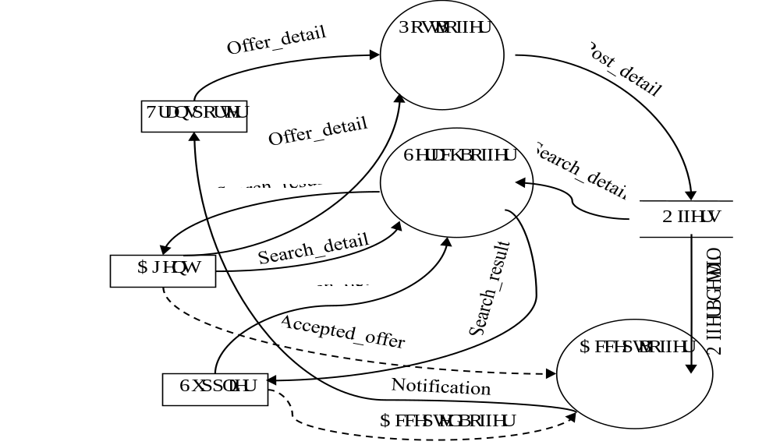
Structured Analysis Method
3. Decomposition of Level 1 DFD

Slide 48
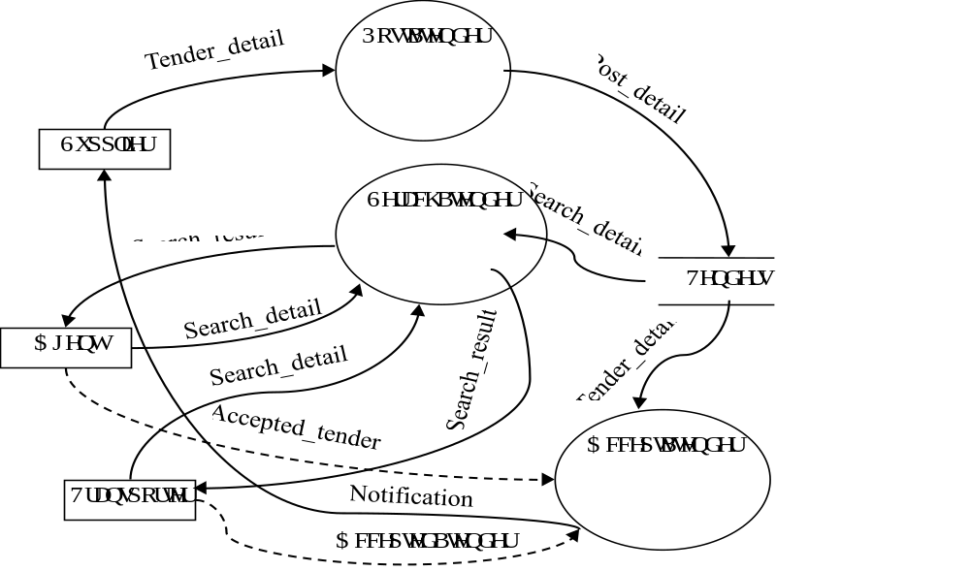
Structured Analysis Method
3. Decomposition of Level 1 DFD
Figure 5.10: Level 2 DFD for Tenders in EtransQ

Slide 49
Structured Analysis Method
4. Identify Man-Machine Boundary
After constructing the final DFD, boundary conditions are identified, which ensures what will be automated and what can be done manually or by another machine.
  For example, in an ATM system, a user will select options, cancel operation, and receive cash and receipt.
  In the EtransQ system, user will access information, add information, make association, select operational details, and perform the verification process.

Slide 50
Structured Analysis Method
5. Prepare Data Dictionary and Process Descriptions
The data flows and processes are defined in the data dictionary with proper structures and formats.
Data dictionary and process for the EtransQ system are shown in Figure 5.11.

Slide 51
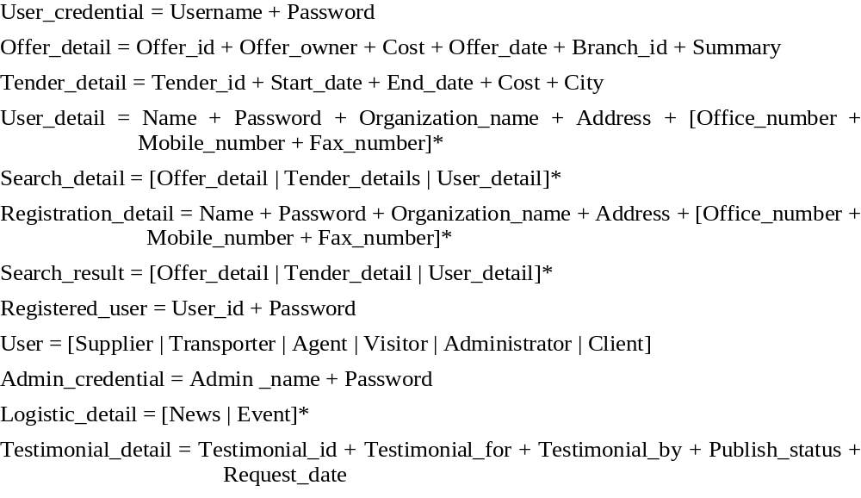
Data dictionary for the EtransQ system
Figure 5.11: Data dictionary for the EtransQ system

Slide 52
Pros and Cons of Structured Analysis
Benefits of Structured Analysis
  A data-flow-based structured analysis is easy to present the customer problems in a pictorial form that can easily be converted into structured design.
  The top-down decomposition approach enables producing a model in an organized manner.
  The DFD-based approach can be used to support other methodologies.
  It does not require much technical expertise
  It helps to understand the system scope and its boundaries.
  It provides proper communication of system knowledge to the users.

Slide 53
Pros and Cons of Structured Analysis
Limitations of Structured Analysis
  It is difficult to understand the final DFD and also it does not reveal the sequence in which processes are performed in the system.
  The structured analysis methodology sometimes becomes a time-consuming and tedious job to manage such voluminous data and to produce several levels of DFD.
  Although a step-by-step approach is suitable for the waterfall model but the system requirements and user requirements must be frozen at the early in the life cycle.
  A complete DFD is constructed if all the requirements are available at the beginning of the structured analysis.

Slide 54
Structured Analysis for Online Food Order System (OFOS)
The online food order system (OFOS) is required to develop an online food order and delivery system that allows restaurants to increase scope of business by reducing the labour cost and customer travel.
The system provides facility to quickly and easily manage an online menu that customers can browse and use to place orders and get food delivered at home without wasting any time.
Restaurants focus on quick preparation and speedy delivery of orders rather than offering a rich dining experience.
The main actors involved in this system are
  Customers are the individuals who need to order food online.
  Suppliers are the ones who supply the food via delivery boy from other administrator/ managers.
  Administrator is an individual or organization who acts as a bridge between customers and suppliers.
  Delivery boy is an individual who takes order from supplier and supplies to the customer.

Slide 55
Business architecture for OFOS
Supplier
Delivery Boy
OFOS
Administrator
Customer

Slide 56
Functional and Non-functional Requirements for OFOS
Functional requirements | Non-functional Requirements
Registration Search Add to cart Place order Generate report Payment Manage delivery | Availability Traceability Efficiency Reliability Maintainability Usability

Slide 57
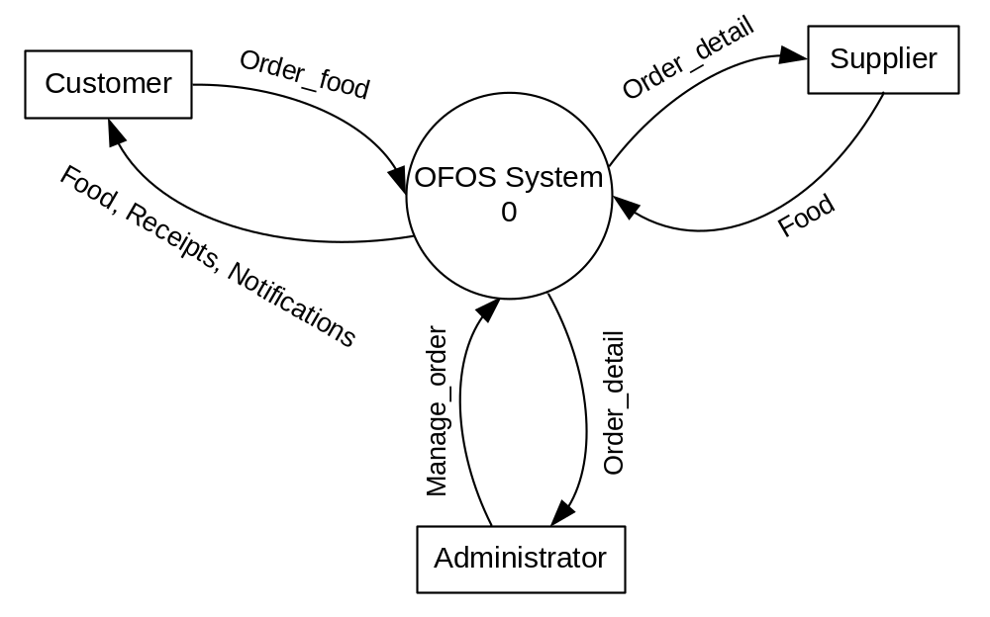
Context diagram for the OFOS

Slide 58
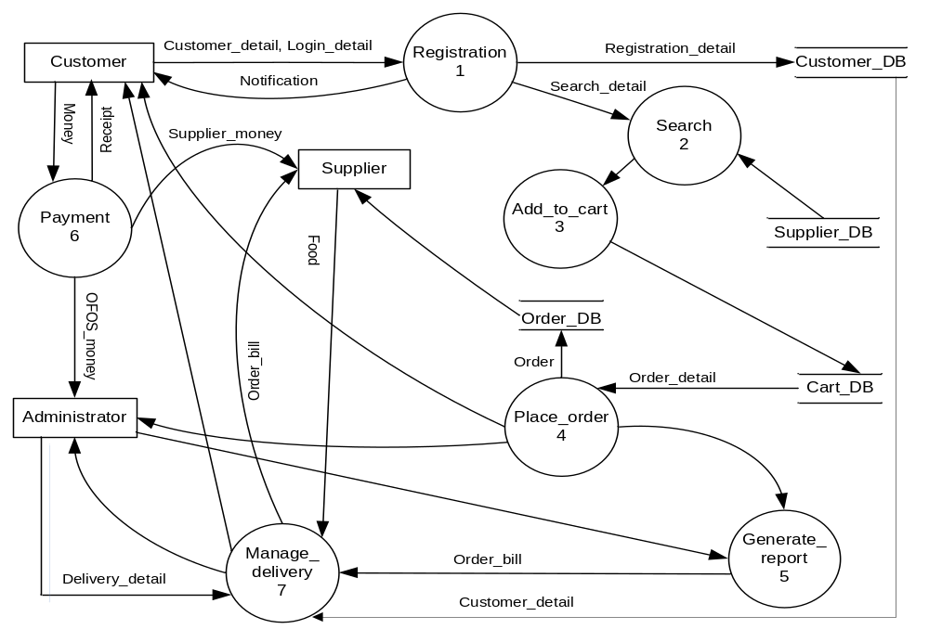
Logical level 1 DFD for the OFOS

Slide 59
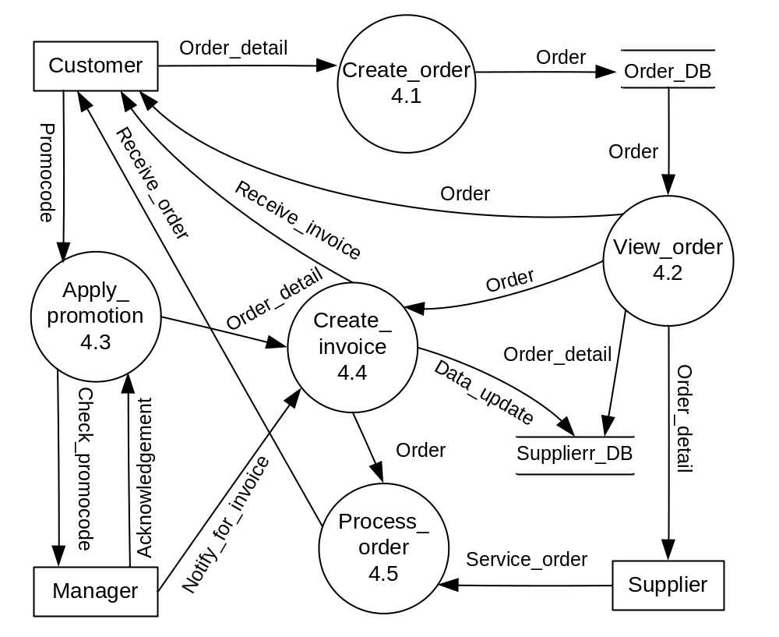
Level 2 DFD for Place_order in the OFOS

Slide 60
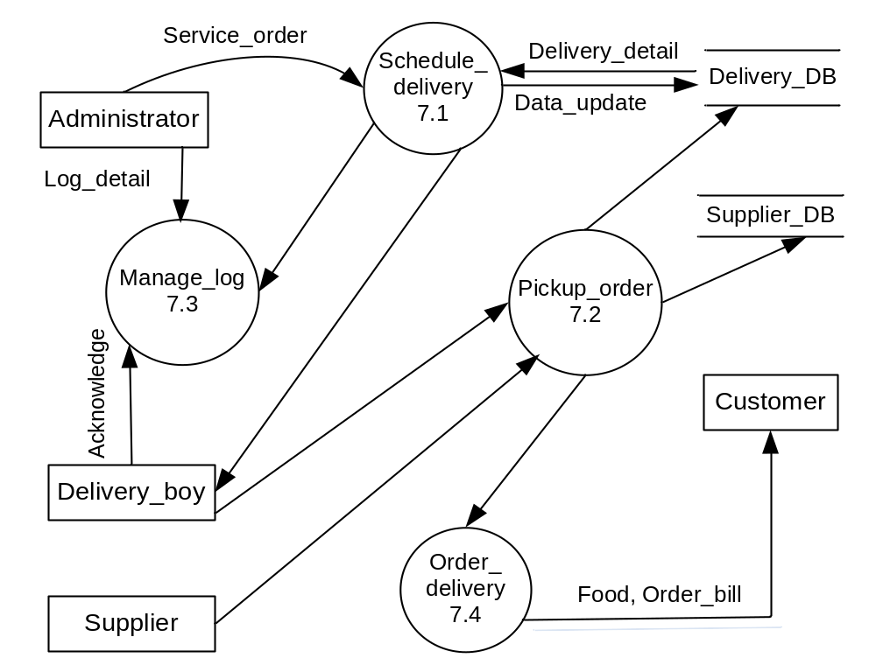
Level 2 DFD for Manage_delivery in the OFOS

Slide 61
Data dictionary for the OFOS
Registration_detail = [Customer_detail + Login_detail]
Customer_detail = Name + Address + Email + Mobile_number
Login_detail = [Password | Mobile_number]
Search_detail = [Restaurant_name + Food_item]*
Order_detail = [Restaurant_name + Food_item + Food_quantity]*
Order = Order_number + Order_detail
OFOS_money = OFOS_commission + Delivery_charges
Supplier_money = Food_charges + Tax_charges
Order_bill = Order_number + [Food_item + Food_quantity + Rate + Amount]*
Schedule_delivery = Delivery_date + Delivery_time + Delivery_boy_detail

Slide 62
Object-Oriented Analysis Method (cont’d)
Object Modeling
Object modeling begins with the problem statement of the application domain.
The problem statement describes the services that will be performed by the system.
The object model captures the static structure of object in the system.
It describes the identity, attributes, relationships to other objects, and the operations performed on the objects.
Object models are constructed using class diagrams after the analysis of the application domain.

Slide 63
Prototyping Analysis
Prototyping is more suitable where requirements are not known in advance, rapid delivery of the product is required, and the customer involvement is necessary in software development.
It is an iterative approach that begins with the partial development of an executable model of the system. It is then demonstrated to the customer for the collection of feedback.
The development of prototype is repeated until it satisfies all the needs and until it is considered the final system.
Prototype can be developed either using automated tools, such as Visual Basic, PHP (Hypertext Preprocessor), 4GL (fourth generation languages), or paper sketching.

Slide 64
Prototyping Analysis (cont’d)
There are two types of prototyping approaches widely used for elicitation, analysis, and requirement validation:
  Throwaway prototyping
  Evolutionary prototyping
In throwaway prototyping, a prototype is built as quickly as possible for the purpose of observing the product's viability.
If the prototype is not acceptable to the customer, then it is totally discarded and the project begins from scratch.
The various versions of the prototype are developed from customer requirements until the customer is satisfied.

Slide 65

Prototyping Analysis (cont’d)
Analysis
Build prototype
Modify requirements
Evaluate
No
Yes
Final system development
Figure 5.22: Throwaway Prototyping

Slide 66
Prototyping Analysis (cont’d)
In evolutionary prototyping, a prototype is built with the focus that the working prototype will be considered the final system.
The process begins with the customer requirements.
The prototypes are produced in several iterations.
They are shown to the customers for their acceptance and customer suggestions are incorporated until the final prototype as the final product is constructed.
This type of prototyping uses the rapid application development (RAD) approach in which automated tools and CASE tools are used for prototype development.

Slide 67
Prototyping Analysis (cont’d)
1st prototype
.
.
n^{th} prototype
Final system
Figure 5.23: Evolutionary prototyping

Slide 68
Requirements Specification
The main focus of the problem analysis approaches is to understand the internal behavior of the software
Requirements are described in a formal document called software requirement specification (SRS).
Software requirement specification (SRS) document is a formal document that provides the complete description of the proposed software, i.e., what the software will do without describing how it will do so.
Software requirements specification is one of the important documents required in the software development.

Slide 69
SRS
SRS is needed for a variety of reasons:
  Customers and users rely more on and better understand a written formal document than some technical specification.
  It provides basis for later stages of software development, viz., design, coding, testing, standard compliances, delivery, and maintenance.
  It acts as the reference document for the validation and verification of the work products and final software.
  It is treated as an agreement on the features incorporated in the final system of project between customer and the supplier.
  A good quality SRS ensures high quality software product.
  A high quality SRS reduces development effort (schedule, cost, and resources) because unclear requirements always lead to unsuccessful projects.

Slide 70
Characteristics of the SRS
Correctness
Unambiguity
Completeness
Consistency
Should be ranked for importance and/or stability
Verifiability
Modifiability
Testability
Validity
Traceability

Slide 71
Components of an SRS
The main focus for specifying requirements is to cover all the specific levels of details that will be required for the subsequent phases of software development and these are agreed upon by the client.
The components of requirement document are as follows:
  Functional requirements
  Performance requirements
  Design constraints (hardware and software)
  External interface requirements

Slide 72
Components of an SRS
Functional Requirements
  Functional requirements describe the functions of the system that it is supposed to have in the software product.
  They specify the functions that will accept inputs, perform processing on these inputs, and produce outputs.
  Functions should include descriptions of the validity checks on the input and output data, parameters affected by the operation and formulas, and other operations that must be used to transform the inputs into corresponding outputs.
  For example, an ATM machine should not process transaction if the input amount is greater than the available balance. Thus, each functional requirement is specified with valid/invalid inputs and outputs and their influences.

Slide 73
Components of an SRS
Performance Requirements
  This component of the SRS specifies the performance characteristics or the nonfunctional aspects of the software system.
  The performance outcomes depend on the operation of the functional requirements.
  Performance requirements are classified as
    Static requirements: These are fixed and they do not impose constraint on the execution of the system.
    Dynamic requirements: specify constraints on the execution behavior of the system. These typically include system efficiency, response time, throughput, system priorities, fault recovery, integrity, and availability constraints on the system.

Slide 74
Components of an SRS
Design Constraints
There are certain design constraints that can be imposed by other standards, hardware limitations, and software constraints at the client’s environment.
These constraints may be related to the standards compliances and policies, hardware constraints (e.g., resource limits, operating environment, etc.), and software constraints.
The hardware constraints limit the execution of software on which they operate.
Software constraints impose restrictions on software operation and maintenance.

Slide 75
Components of an SRS
External Interface Requirements
The external interface specification covers all the interactions of the software with people, hardware, and other software.
The working environment of the user and the interface features in the software must be specified in the SRS.
The external interface requirement should specify the interface with other software.
It includes the interface with the operating system and other applications.

Slide 76
Structure of an SRS
The structure of the SRS describes the organization of the software requirement document.
The best way to specify requirements is to use predefined requirements specification templates.
The specific requirement subsection of the SRS should contain all of the software requirements to a level of detail sufficient to enable designers to design a system to satisfy those requirements, and testers to test that the system satisfies those requirements.
It includes functional requirements, performance requirements, design constraints, and external interface requirements.

Slide 77
IEEE structure of SRS
  1. Introduction
  1.1 Purpose
  1.2 Scope
  1.3 Definitions, acronyms, and & abbreviations
  1.4 References
  1.5 Document overview
  2. General description
  2.1 Product perspective
  2.2 Product functions
  2.3 User characteristics
  2.4 General constraints
  2.5 Assumptions and& dependencies
  3. Specific requirements
  3.1 Functional requirements
    3.1.1 Functional requirement 1
      3.1.1.1 Introduction
      3.1.1.2 Input
      3.1.1.3 Processing
      3.1.1.4 Output
    3.1.N Functional requirement M
  3.2 External interface requirements
  3.3 Performance requirements
  3.4 Design constraints
  3.5 Security requirements
  3.6 Maintainability requirements
  3.7 Reliability requirements
  3.8 Availability requirements
  3.9 Database requirements
  3.10 Documentation requirements
  3.11 Safety requirements
  3.12 Operational requirements
  3.13 Site adaptation

Slide 78
Requirements Specification Methods
Requirements specified in natural languages are ambiguous and confusing since they may be interpreted differently by different people.
There are some complex and difficult statements in the user requirements, which need to be specified using technical tools or other formal methods.
Most commonly used methods are:
  Decision tree and tables,
  Regular expressions,
  Program Design Language (PDL),
  Graphical methods,
  Mathematical methods.

Slide 79
Requirements Specification Methods (cont’d)
Decision Tree and Decision Table
A decision tree is a tree-like representation of a complex logic.
In a decision tree, edges are labeled by conditions and the leaf nodes are represented with actions.
Decision tables are made just like tables with rows and columns.
Decision tables are heavily used for representing the decision logic.
There are certain advantages of using decision tables over decision trees and vice versa.

Slide 80
Requirements Specification Methods (cont’d)
Example 5.2: Student promotion system (SPS)
A student grading system promotes the students to the next session on the basis of the university rules.
A student has to complete subjects of 52 credits in a session and maintain 4.00 SGPA to take admission in the next session.
Otherwise, a fresh admission will be allowed in the same course. Represent this information in the decision table and decision tree.

Slide 81
Requirements Specification Methods (cont’d)
Figure 5.25: Decision tree for Student Promotion System
>= 4
Promotion
SGPA
Yes
Credits >= 52
< 4
Readmission
No
Incomplete credits

Slide 82
Requirements Specification Methods (cont’d)
Table 5.1: Decision table for student promotion system
Condition stub | Condition entry
Credits >= 52 | No | Yes | Yes
SGPA >= 4 | - | No | Yes
Action stub | Action entry
Incomplete credits | ×
Promotion |  |  | ×
Readmission |  | ×

Slide 83
Requirements Specification Methods (cont’d)
Program Design Language (PDL)
Program Design Language (PDL) is a method of specifying procedures of functional requirements in the software.
It represents the requirements in the form of pseudo code and structured languages. It adds more abstract constructs to increase its expressive power.
Various special purpose requirements specification languages have been designed, such as the Problem Statement Language (PSL)/Problem Statement Analyzer (PSA) and Requirements Statement Language (RSL).
Requirements expressed in PDL are easy to understand and translate into programming languages.
In PDL, it becomes difficult to express the domain concepts in an understandable manner.
Also, the specification is considered a design rather than a specification.

Slide 84
PDL for SPS
Figure 5.26: A PDL for SPS
Procedure SPS is
BEGIN
LOOP
read student_result (credits, SGPA)
IF credits is greater than 52
THEN calculate SGPA
ELSE
message incomplete credits
ENDIF
IF SGPA is greater than 4.00
THEN promote()
ELSE readmit()
ENDIF
END LOOP

Slide 85
Requirements Specification Methods (cont’d)
Regular Expressions
A regular expression is a pattern that describes the syntactical structure of a set of strings.
Most of the software involves the processing of strings. The common patterns of requirements are described by regular expressions.
Regular expressions are used for describing patterns of requirements, searching a substring within a string, for lexical analysis, describing metadata, etc.
The building blocks for regular expressions are the single characters or digits that match themselves.

Slide 86
Requirements Specification Methods (cont’d)
Regular Expressions
If r₁ and r₂ are regular expressions of languages L (r₁) and L (r₂), then
  (r₁) is a regular expression denoting L (r₁).
  r₁| r₂ is a regular expression denoting L (r1) U L (r2).
  r₁ r₂ is a regular expression denoting L (r₁) L (r₂).
  r₁* is a regular expression denoting L (r₁)*.
For example, the language {a*ba*} denotes the set {b, aba, aabaa, …}.

Slide 87
Requirements Specification Methods (cont’d)
Graphical Methods
Graphical methods provide more comprehensible representation than their textual counterpart.
There exist various methods, such as data flow diagrams (DFD), E-R modeling, finite state machines (FSM), etc.
Finite state machines (FSM)
  are used to represent the behavior of a system or a complex object with certain conditions.
  It consists of four elements: states, state transitions,
    rules or conditions, input events.

Slide 88
Requirements Specification Methods (cont’d)
Finite state machines (FSM)
A FSM has an initial state and a set of final states.
FSM can be expressed as a state table to represent the transition function and the output function for all types of states and inputs.
FSMs are useful for real time software.
But in case of a large system, number of nodes and transitions become unwieldy and unmanageable.

Slide 89

Requirements Specification Methods (cont’d)
Example 5.3: FSM for reading even number of 0s (e.g., 00, 0000, 000000, etc.).
Current state | Current input
 | 0
S₀ | S₁
S₁ | S₂
S₂ | S₁
Figure 5.27: FSM for even number of 0s

Slide 90
Requirements Specification Methods (cont’d)
Mathematical Methods
Mathematical methods are formal requirement specification approaches that are used to model complex systems in mathematical terminologies.
The proof of correctness is the goal of mathematical specification, which can help to identify faulty reasoning far earlier than in the traditional design.
The specifications are clear, unambiguous and provable but these are difficult to understand for the customer.
Formal specifications can automatically be processed using automated tools.
Mathematical specifications are programming independent.

Slide 91
Requirements Specification Methods (cont’d)
There are various formal mathematical methods, such as algebraic specifications, axiomatic specifications, etc.
Algebraic and axiomatic specification consists of the following three constituent elements:
Specification = (Sort, Operation, Axioms);
Sort is a set of values that describes the type or class (e.g., integers, stacks of integers, strings, complex, etc.).
Operation specifies the name of the operation, its parameters and return type; for example, push: stack x element -> stack.
Axioms are the rules that must hold true in any legal implementation of sort.

Slide 92
Requirements Specification Methods (cont’d)
Example 5.4: A string supports various operations like create, append, concatenate, length, empty, and equal operations. Specify the string operations in algebraic specification.
The algebraic specification of the string operations is:
  Sorts: string, char, size, boolean.
  Operations : create: () -> string
            append: string, string -> string
            concatenate: string, char -> string
            length: string -> size
            isEmpty: string -> boolean
            equal: string, string -> boolean

Slide 93
Requirements Specification Methods (cont’d)
Example 5.4:
Axioms: s1, s2: string; c: char
isEmpty (new()) = true
isEmpty (concatenate(s1,c)) = false
length (new()) = 0
length (concatenate(s1,c)) = length (s1) + 1
append (s1, new()) = s1
append (s1, concatenate(s2,c)) = concatenate(append(s1,s2), c)
equal (new(), new()) = true
equal (new(), concatenate(s1,c)) = false
equal (concatenate(s1,c), new()) = false
equal (concatenate(s1,c), concatenate(s2,c)) = equal(s1,s2)

Slide 94
Requirements Validation
Requirement validation is an iterative process in the requirements development process that ensures that customer requirements are accurately and clearly specified in the SRS document, i.e., omission, inconsistency, incorrect fact, and ambiguity.
Requirement validation methods,
  requirements review,
  inspection,
  test case generation,
  reading, and
  prototyping.

Slide 95
Requirements Validation (cont’d)
Requirements Review
It is a formal process of requirement validation, which is performed by a group of people from both sides, i.e. clients and developers.
Requirements review is one of the most widely used and successful techniques to detect errors in requirements.
Requirements review helps to address problems at early stages of software development.
Although requirement reviews take time but they pay back by minimizing the changes and alteration in the software.

Slide 96
Requirements Validation (cont’d)
Requirement Inspection
It is an effective way for requirement validation that detects defects at early stages.
Inspection is a costly and time-consuming process because large number of requirement artifacts are analyzed, searched, and sorted.
Inspection can detect up to 90% defects.
The inspection process correctly gives results for small and less complex projects.
It is not a common practice in industry due to the cost which is associated to it.

Slide 97
Requirements Validation (cont’d)
Test Case Generation
Test case generation techniques for requirements validation ensure that requirements are clear, complete, consistent, and testable before development begins.
The purpose of this technique is to ensure that requirements are good enough for the product and planning activities.
It removes the defects before a project starts and during the project execution and development .
In this technique, the product manager and the tester select and review the high priority requirements and least priority requirements are discarded in the initial specification.
Writing test cases early may result in some rework if the requirements change, but this rework cost will be lower than finding and fixing defects in the later stages.

Slide 98
Requirements Validation (cont’d)
Reading
Reading is a technique of reviewing requirements in which the reader applies his knowledge to find the defects.
There are various reading techniques, such as ad-hoc based, checklist based, etc..
Detection of the defect depends upon the knowledge and experience of the reviewer.
Checklist-based reading is one of the commonly used techniques in which a set of questions is given to the reviewer as a checklist.

Slide 99
Requirements Validation (cont’d)
Prototyping
Prototyping is mostly used to understand, analyze, and validate the requirements of a system.
In requirements validation, prototyping helps to identify the errors like missing, incomplete, and incorrect requirements from the requirements document.
Prototyping works with developing an executable model of the proposed system. This is developed in an incremental manner.
In each increment, defects are identified and discussed with the stakeholders and corrective actions are taken accordingly.

Slide 100
Requirements Management
Requirements management is the process of systematically collecting, organizing, documenting, prioritizing, and negotiating on the requirements for a project.
Requirements management planning is a continuous and cross-sectional process that continues throughout the project life span.

Slide 101
Requirements Management (cont’d)
The main activities of requirements management are as follows:
  Planning for the project requirements
  Focusing on the requirements identification process
  Managing the requirements changes
  Controlling and tracking the changes
  Agreeing on the requirements among stakeholders
  Performing regular requirements reviews
  Performing impact analysis for the required changes

